Slide 1
Chapter 10 – Agile Software Development
Anh Nguyen-Duc
Tho Quan
WEEK 10

Slide 2
Topics covered
Agile methods
Scrum in nutshell
Other Agile approaches

Slide 3
Rapid software development
Rapid development and delivery is now often the most important requirement for software systems
Businesses operate in a fast-changing requirement
=> practically impossible to have stable software requirements
Software has to evolve quickly to reflect changing business needs.
Plan-driven development (waterfall, incremental dev.) is essential for some types of system but does not meet these business needs.
Notes:
Rapid development and delivery is now often the most important requirement for software systems
Businesses operate in a fast-changing requirement and it is practically impossible to produce a set of stable software requirements
Software has to evolve quickly to reflect changing business needs.
Plan-driven development is essential for some types of system but does not meet these business needs.
Agile development methods emerged in the late 1990s whose aim was to radically reduce the delivery time for working software systems

Slide 4
Agile development
emerged in the late 1990s
aim to radically reduce the delivery time for working software systems
Program specification, design and implementation are inter-leaved
The system = a series of versions / increments
Stakeholders involved in version specification and evaluation
Frequent delivery of new versions for evaluation
Minimal documentation – focus on working code
Extensive tool support (e.g. automated testing tools) used to support development.
Notes:
Program specification, design and implementation are inter-leaved
The system is developed as a series of versions or increments with stakeholders involved in version specification and evaluation
Frequent delivery of new versions for evaluation
Extensive tool support (e.g. automated testing tools) used to support development.
Minimal documentation – focus on working code

Slide 5
Plan-driven and agile development
i.e.: waterfall model, incremental development
Notes:
Plan-driven development
A plan-driven approach to software engineering is based around separate development stages with the outputs to be produced at each of these stages planned in advance.
Not necessarily waterfall model – plan-driven, incremental development is possible
Iteration occurs within activities.
Agile development
Specification, design, implementation and testing are inter-leaved and the outputs from the development process are decided through a process of negotiation during the software development process.

Slide 6
Agile methods

Slide 7


The Agile Manifesto
Individuals and interactions
Process and tools
over
Working software
Comprehensive documentation
over
Customer collaboration
Contract negotiation
over
Responding to change
Following a plan
over
Source: www.agilemanifesto.org
Notes:
4 values and 12 principles
Valuing people more highly than processes or tools is easy to understand because it is the people who respond to business needs and drive the development process. If the process or the tools drive development, the team is less responsive to change and less likely to meet customer needs.
Historically, enormous amounts of time were spent on documenting the product for development and ultimate delivery. Technical specifications, technical requirements, technical prospectus, interface design documents, test plans, documentation plans, and approvals required for each. Agile documents requirements as user stories, which are sufficient for a software developer to begin the task of building a new function.
Negotiation is the period when the customer and the product manager work out the details of a delivery, with points along the way where the details may be renegotiated. Collaboration is a different creature entirely. With development models such as Waterfall, customers negotiate the requirements for the product, often in great detail, prior to any work starting. This meant the customer was involved in the process of development before development began and after it was completed, but not during the process. The Agile Manifesto describes a customer who is engaged and collaborates throughout the development process, making. This makes it far easier for development to meet their needs of the customer.
Traditional software development regarded change as an expense, so it was to be avoided. The intention was to develop detailed, elaborate plans, with a defined set of features and with everything,
With Agile, the shortness of an iteration means priorities can be shifted from iteration to iteration and new features can be added into the next iteration.

Slide 8
Value 1: Individuals and Interactions over Processes and Tools
Strong players: a must, but can fail if don’t work together.
Strong player: not necessarily an ‘ace;’ work well with others!
Communication and interacting is more important than raw talent.
‘Right’ tools are vital to smooth functioning of a team.
Start small. Find a free tool and use until you can demo you’ve outgrown it. Don’t assume bigger is better. Start with white board; flat files before going to a huge database.
Building a team more important than building environment.
Some managers build the environment and expect the team to fall together.
Doesn’t work.
Let the team build the environment on the basis of need.

Slide 9
Value 2: Working Software over Comprehensive Documentation
Code – not ideal medium for communicating rationale and system structure.
Team needs to produce human readable documents describing system and design decision rationale.
Too much documentation is worse than too little.
Take time; more to keep in sync with code; Not kept in sync? it is a lie and misleading.
Short rationale and structure document.
Keep this in sync; Only highest level structure in system kept.
Fatal flaw: Pursue documentation instead of software:
Rule: Produce no document unless need is immediate and significant.

Slide 10
Value 3: Customer Collaboration over Contract Negotiation (1 of 2)
Not possible to describe software requirements up front and leave someone else to develop it within cost and on time.
Customers cannot just cite needs and go away
Successful projects require customer feedback on a regular and frequent basis – and not dependent upon a contract or SOW.

Slide 11
Value 3: Customer Collaboration over Contract Negotiation (2 of 2)
Best contracts are NOT those specifying requirements, schedule and cost.
Become meaningless shortly.
Far better are contracts that govern the way the development team and customer will work together.
Key is intense collaboration with customer and a contract that governed collaboration rather than details of scope and schedule
Details ideally not specified in contract.
Rather contracts could pay when a block (deliverable) passed customer’s acceptance tests.
With frequent deliverables and feedback, acceptance tests never an issue.

Slide 12
Value 4: Responding to Change over Following a Plan
Our plans and ability to respond to changes is critical!
Course of a project cannot be predicted far into future.
Too many variables; not many good ways at estimating cost
As developers gain knowledge of the system and as customer gains knowledge about their needs, some tasks will become unnecessary.
Better planning strategy: – make detailed plans for the next few weeks, very rough plans for the next few months, and extremely crude plans beyond that.
Need to know what we will be working on the next few weeks; roughly for the next few months; a vague idea what system will do after a year.
Only invest in a detailed plan for immediate tasks; once plan is made, difficult to change due to momentum and commitment.
The lower resolution parts of the plan can be changed with relative ease.

Slide 13
Introduction to SCRUM
Notes:
an ordered formation of players, used to restart play, in which the forwards of a team form up with arms interlocked and heads down, and push forward against a similar group from the opposing side. The ball is thrown into the scrum and the players try to gain possession of it by kicking it backwards towards their own side.

Slide 14
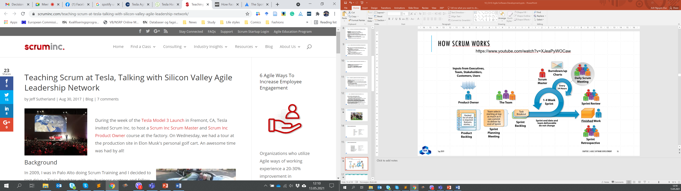
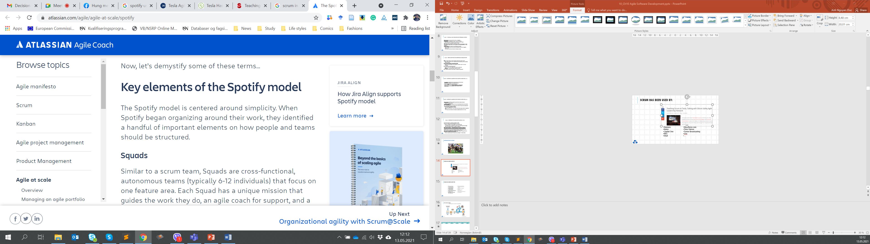
Scrum has been used by:
Microsoft
Yahoo
Google
Electronic Arts
High Moon Studios
Lockheed Martin
Philips
Siemens
Nokia
Capital One
BBC
Intuit
Nielsen Media
First American Real Estate
BMC Software
Ipswitch
John Deere
Lexis Nexis
Sabre
Salesforce.com
Time Warner
Turner Broadcasting
Oce
…

Slide 15
Scrum has been used for:
Commercial software
In-house development
Contract development
Fixed-price projects
Financial applications
ISO 9001-certified applications
Embedded systems
24x7 systems with 99.999% uptime requirements
Video game development
FDA-approved, life-critical systems
Satellite-control software
Websites
Handheld software
Mobile phones
Network switching applications
ISV applications

Slide 16
How scrum works
https://www.youtube.com/watch?v=XJeaPyWOCaw

Slide 17
Scrum framework
Ceremonies
Roles
Artifacts
Sprint planning
Sprint review
Sprint retrospective
Daily scrum meeting
Product owner
ScrumMaster
Team
Product backlog
Sprint backlog
Burndown charts

Slide 18
SCRUM

Slide 19
Scrum roles
Roles
Product owner
ScrumMaster
Team

Slide 20

Product owner
Define the features of the product
Decide on release date and content
Be responsible for the profitability of the product (ROI)
Prioritize features according to market value
Adjust features and priority every iteration, as needed
Accept or reject work results

Slide 21

Scrum Master
Represents management to the project
Responsible for enacting Scrum values and practices
Removes impediments
Ensure that the team is fully functional and productive
Enable close cooperation across all roles and functions
Shield the team from external interferences
Notes:
https://www.youtube.com/watch?v=CZnWiVhpdzQ

Slide 22





The team
Typically 5-9 people
Cross-functional:
Programmers, testers, user experience designers, etc.
Members should be full-time
May be exceptions (e.g., database administrator)
Teams are self-organizing
Ideally, no titles but rarely a possibility
Membership should change only between sprints

Slide 23
Scrum CEREMONIES
Ceremonies
Sprint planning
Sprint review
Sprint retrospective
Daily scrum meeting

Slide 24

Sprint planning
Decide how to achieve sprint goal (design)
Team selects items from the product backlog they can commit to completing
Create sprint backlog (tasks) from product backlog items (user stories / features)
Estimate sprint backlog in hours. Tasks is estimated (1-16 hours)
Collaboratively, not done alone by the ScrumMaster
As a vacation planner, I want to see photos of the hotels.
Code the middle tier (8 hours)
Code the user interface (4)
Write test fixtures (4)
Code the foo class (6)
Update performance tests (4)

Slide 25
The daily scrum ( Your version: Bi/weekly Scrum)
Daily, 15-minutes, stand-up
Not for problem solving
Moderated by a Scrum Master
Three questions:
What did you do yesterday?
What will you do today?
Is anything in your way?

Slide 26
The Sprint review meeting (Our formal supervision meeting)
Team presents what it accomplished during the sprint
Typically takes the form of a demo of new features or underlying architecture
Informal
2-hour prep time rule
No slides
Whole team participates
Invite the world

Slide 27
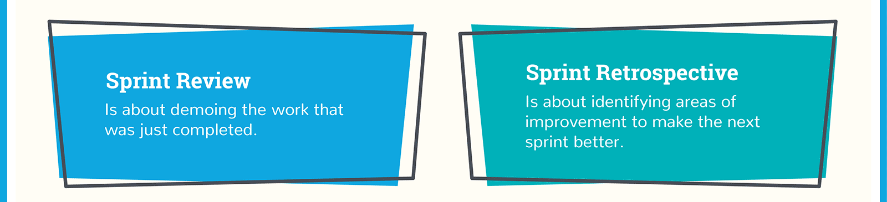
Sprint retrospective meeting
Periodically take a look at what is and is not working
Typically 15–30 minutes
Done after every sprint
Whole team participates
Moderated by a Scrum Master
Each team member is asked to identify specific things that the team should:
Start doing
Stop doing
Continue doing
Notes:
https://www.youtube.com/watch?v=MiaZhJyYUj0

Slide 28
IN-class Exercise
Reflect on tools, collaboration, teamwork, meetings, etc. you have done so far in the project. Perform the retrospective within your team:
One team member act as a Scrum Master
The Scrum master asks each team member about what he/ she will:
Start doing
Stop doing
Continue doing

Slide 29
Scrum ARTIFACTS
Artifacts
Product backlog
Sprint backlog
Burndown charts

Slide 30
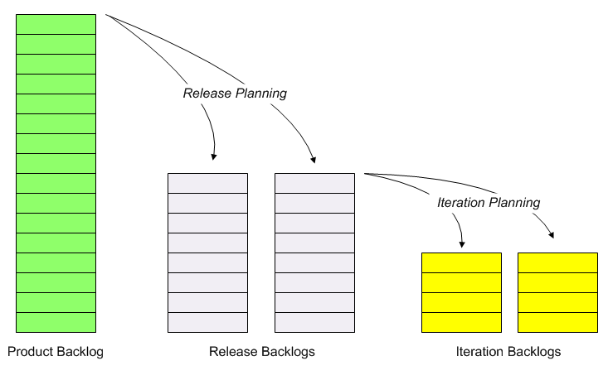
Product backlog vs. sprint backlog
www.synerzip.com
Notes:
Let the finger pointing begin! This is the place where the rubber hits the road. It is especially easy for people to quickly assess the situation and identify anyone else who was the cause of the debacle. This is the greatest point of contention amongst teams. This is also the greatest opportunity for the team to retrospect and adjust in order to prevent this from happening in the future.
The key here is to stop pointing fingers and start searching for clues…

Slide 31
User stories
An informal, natural language description of one or more features of a software system
Written from the perspective of an end user
A common pattern:
As a <role> I can/ want <capability>, so that <receive benefit>

Slide 32
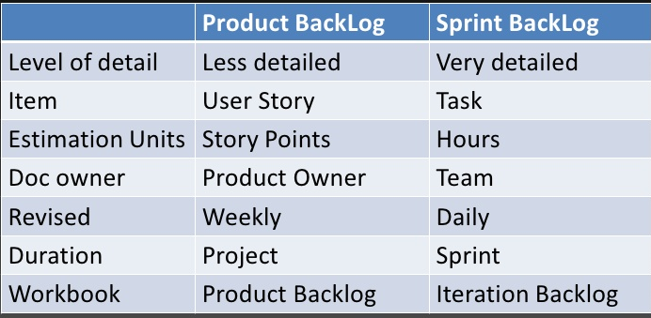
User stories in Sprint backlog vs Product Backlog

Slide 33
Effort estimation
In the beginning of the Sprint, we should be able to tell how long/ how costly it will take to accomplish User Story ABC
“I think it will take me five days full-time to finish the User Story ABC”
“This week I have a midterm exam, so I take me all together seven days…”
“This User Story ABC might need 3000 Line of Codes…”
“This User Story ABC will have 3 user interfaces…”
“ I would give it 5 out of 10 points in term of efforts needed”
Many different approaches for estimation
No estimation is perfect
What is important is to have the consistent understanding about the effort/ complexity of the task/ the user story throughout the WHOLE team

Slide 34
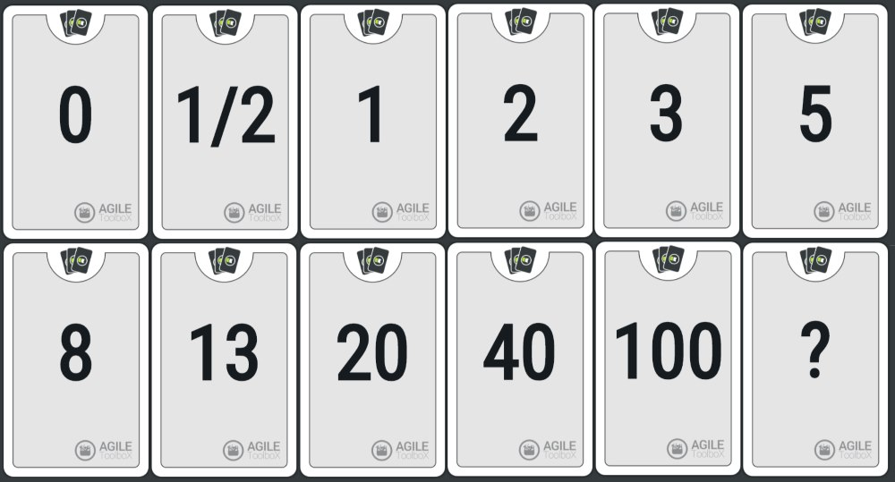
Planning poker
Notes:
Planning poker, also called Scrum poker, is a consensus-based, gamifiedtechnique for estimating, mostly used to estimate effort or relative size of development goals in software development. In planning poker, members of the group make estimates by playing numbered cards face-down to the table, instead of speaking them aloud. The cards are revealed, and the estimates are then discussed. By hiding the figures in this way, the group can avoid the cognitive bias of anchoring, where the first number spoken aloud sets a precedent for subsequent estimates.
To begin, each team member is given a set of cards with numbers on them. The numbers are usually ordered from 0 to 21 using the Fibonacci sequence: 0, 1, 2, 3, 5, 8, 13, and 21.
Then each story is read aloud. After each story is presented, everybody on the team is asked to hold up the card showing the level of effort that they believe this story represents for the team.
Initially the estimates may be all over the map. But after a while the team will get a sense of how much effort they all estimate is associated with a typical type of story.
Once all the votes are in, the team members with the lowest and highest estimates explain why they chose their scores.
Frequently, experts with detailed knowledge may be able to tell the rest of the team why a certain story is actually much easier than they thought, or why it may be more difficult than it first appears because of unexpected requirements.
Through this process, everybody on the team learns more about what’s involved in estimating stories both inside and outside of their specialties, increasing knowledge sharing across the entire team.
With planning poker, the numbers are significant. A story estimated as a 2 should be about one fourth as difficult as a story estimated as an 8.
Stories estimated at 20 or higher may be so large that they need to broken up into smaller stories before they can be attempted.

Slide 35
Planning poker
For each user story, a team member can give a number 0, 1, 2, 3, 5, 8, 13, and 21 (A story estimated as a 2 should be about one fourth as difficult as a story estimated as an 8)
0 is the most simple/ easiest
21 is the most difficult/ most effort needed
A moderator ask each member:
Read aloud the number
The team members with the lowest and highest estimates explain why they chose their scores
Discuss until the team reach consensus on one number
Notes:
Planning poker, also called Scrum poker, is a consensus-based, gamifiedtechnique for estimating, mostly used to estimate effort or relative size of development goals in software development. In planning poker, members of the group make estimates by playing numbered cards face-down to the table, instead of speaking them aloud. The cards are revealed, and the estimates are then discussed. By hiding the figures in this way, the group can avoid the cognitive bias of anchoring, where the first number spoken aloud sets a precedent for subsequent estimates.
To begin, each team member is given a set of cards with numbers on them. The numbers are usually ordered from 0 to 21 using the Fibonacci sequence: 0, 1, 2, 3, 5, 8, 13, and 21.
Then each story is read aloud. After each story is presented, everybody on the team is asked to hold up the card showing the level of effort that they believe this story represents for the team.
Initially the estimates may be all over the map. But after a while the team will get a sense of how much effort they all estimate is associated with a typical type of story.
Once all the votes are in, the team members with the lowest and highest estimates explain why they chose their scores.
Frequently, experts with detailed knowledge may be able to tell the rest of the team why a certain story is actually much easier than they thought, or why it may be more difficult than it first appears because of unexpected requirements.
Through this process, everybody on the team learns more about what’s involved in estimating stories both inside and outside of their specialties, increasing knowledge sharing across the entire team.
With planning poker, the numbers are significant. A story estimated as a 2 should be about one fourth as difficult as a story estimated as an 8.
Stories estimated at 20 or higher may be so large that they need to broken up into smaller stories before they can be attempted.

Slide 36

BURNDOWN ChART
Tasks
Mon
Tues
Wed
Thur
Fri
Code the user interface
8
4
8
Code the middle tier
16
12
10
7
Test the middle tier
8
16
16
11
8
Write online help
12
50
40
30
Hours
20
10
0
Mon
Tue
Wed
Thu
Fri

Slide 37
Scrum benefits
The product is broken down into a set of manageable and understandable chunks.
Unstable requirements do not hold up progress.
The whole team have visibility of everything and consequently team communication is improved.
Customers see on-time delivery of increments and gain feedback on how the product works.
Trust between customers and developers is established and a positive culture is created in which everyone expects the project to succeed.

Slide 38
Extreme programming
Extreme Programming (XP) takes an ‘extreme’ approach to iterative development.
New versions may be built several times per day;
Increments are delivered to customers every 2 weeks;
All tests must be run for every build and the build is only accepted if tests run successfully.
The XP release cycle
Notes:
A very influential agile method, developed in the late 1990s, that introduced a range of agile development techniques.
Extreme Programming (XP) takes an ‘extreme’ approach to iterative development.
New versions may be built several times per day;
Increments are delivered to customers every 2 weeks;
All tests must be run for every build and the build is only accepted if tests run successfully.

